Slide 1


Capstone Project
Marketing and Retail Analytics
SPARSH VIJAY
sparshvijay1710@gmail.com

Slide 2
Contents
Problem Statement
Understanding Dataset
Insights & Findings
Market Basket Analysis
Conclusion & Suggestions

Slide 3
Problem Statement
In the recent past, e-commerce companies have emerged and flourished in the industry. They offer the convenience to order from a wide variety of options from the comfort of one’s home. But how do they offer these “wide variety of options or products”? To be able to meet the demands of the customers, any e-commerce company would obviously need to store tons and tons of products in warehouses. Now, some of these warehoused products might be fast-moving products which sell very quickly and some others might be slow-moving. Each of the products being stored incurs a cost to the company in terms of space and maintenance. Since storing these products obviously add to the costs that the company incurs, it is absolutely necessary for the organisations to plan their inventory well.
Now, OList is one such e-commerce company that has faced some losses recently and they want to manage their inventory very well so as to reduce any unnecessary costs that they might be bearing. In this assignment, you have to manage the inventory cost of this e-commerce company OList. You need to identify top products that contribute to the revenue and also use market basket analysis to analyse the purchase behaviour of individual customers to estimate with relative certainty, what items are more likely to be purchased individually or in combination with some other products.

Slide 4
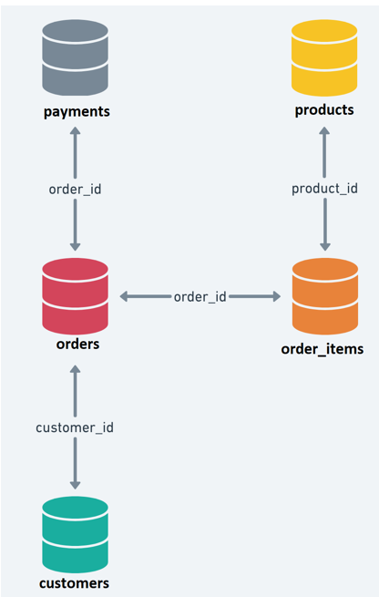
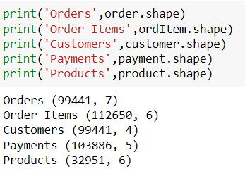
Understanding Dataset
There are 5 datasets namely – Order, Order Items, Customer, Payments and Products.
Following were the no. of rows in each table:
As per problem statement we are supposed to consider those records in order table which have status set as Delivered. After making the following change there are 96456 records left.

Slide 5

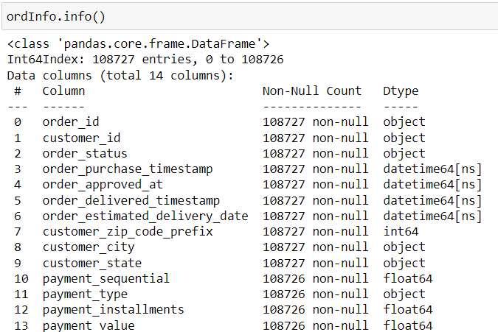
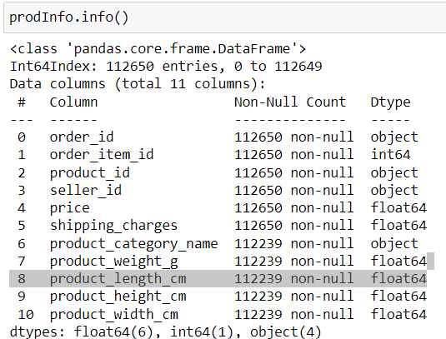
Rest of the tables have negligible null values which are treated by dropping those records.
Orders table works like a fact table as it acts as a link across three tables. The data is pretty consistent and it does not have much null value percentage.
There were no outliers observed in any of the tables.
The 5 Datasets were merged into two tables:
ordInfo - A merge of payment and left_merged table where left_merged table is fromed by merging of order_del and customer table.
prodInfo - A merge of order items table and product table.

Slide 6
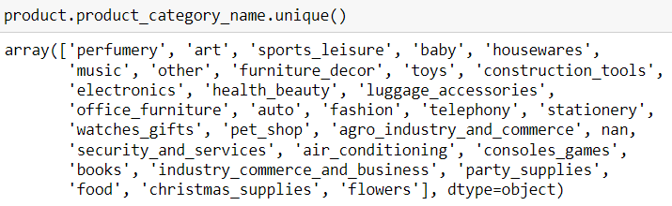
Challenges with Dataset
There were a lot of garbage values in product_category_name field in Product table which needed some treatment to be done. There were 70 values assigned to it. Those values were regrouped in a manner so that our analysis doesn't get hampered. There are 30 product categories now. (Refer the python script to know more)
The challenge which the data brought was it was missing some important information like product name or sub-category name which could have made the analysis more granular.

Slide 7
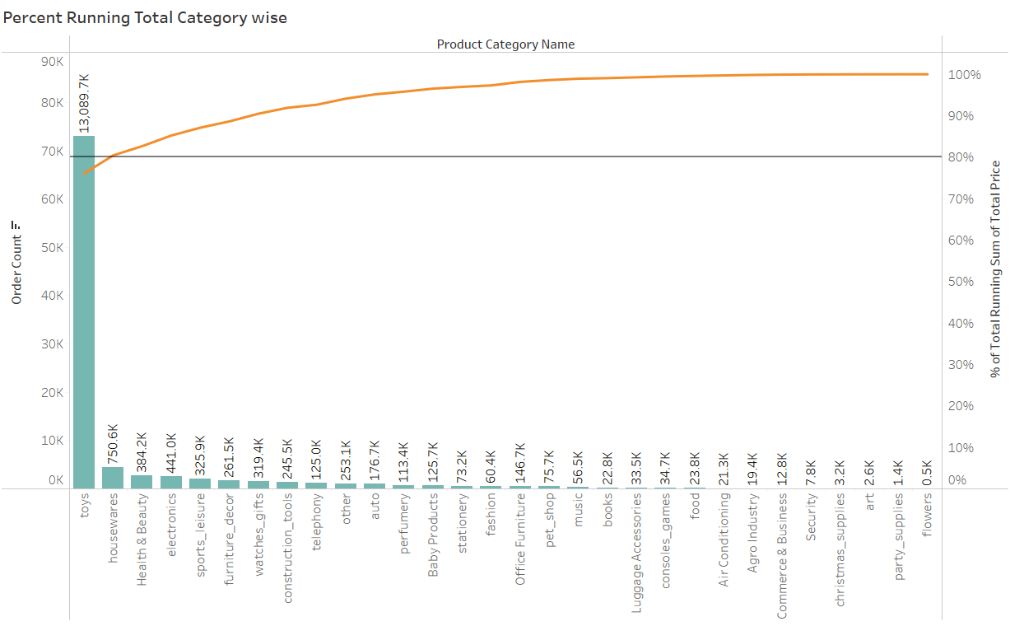
Insights & Findings
It can be clearly inferred from the visuals that Toys is the category which is mostly bought by the customers and that the reason its contributing to 87% of the quantity share and 76% Revenue share.

Slide 8
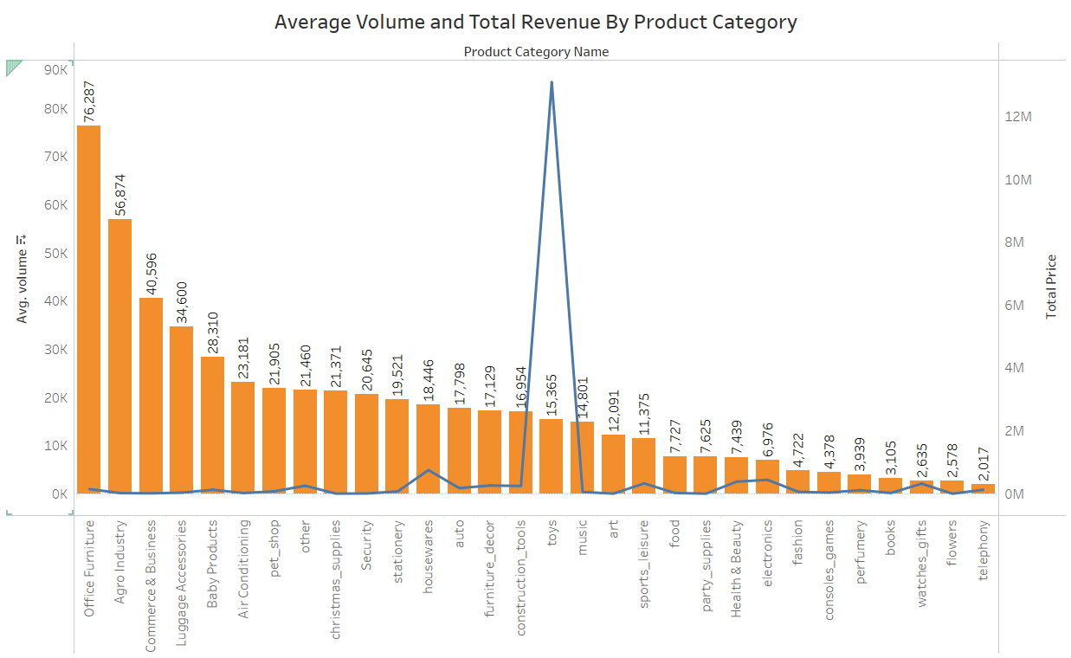
It can be inferred that toys is the category with less average volume and higher revenue where as Office Furniture and Agro Industry has much less revenue and very high Average volume

Slide 9
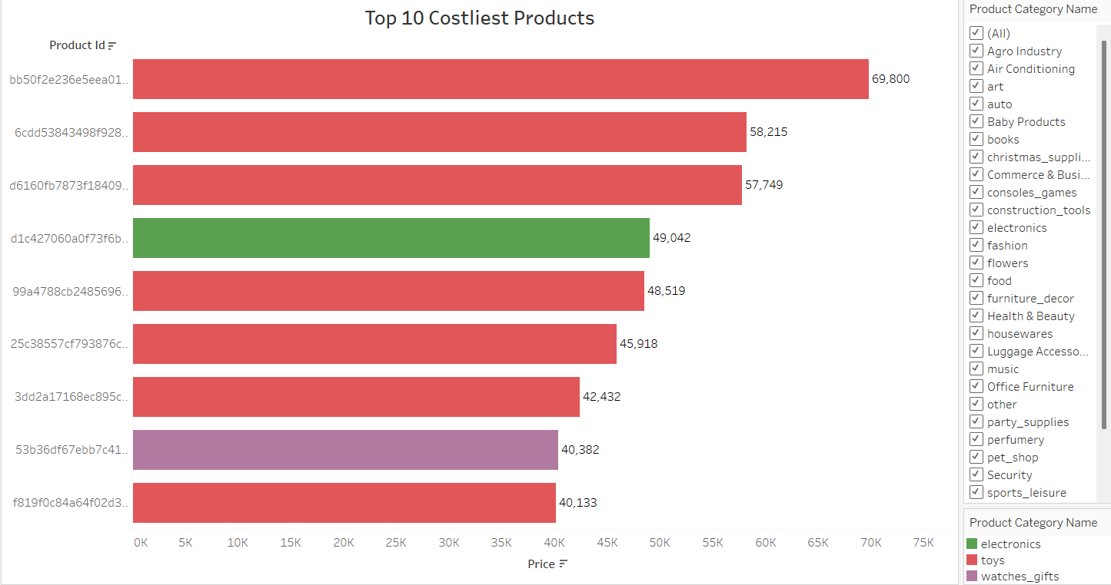
Out of 30 product Categories, Toys has most number products which are costly followed by Electronics and watches.

Slide 10
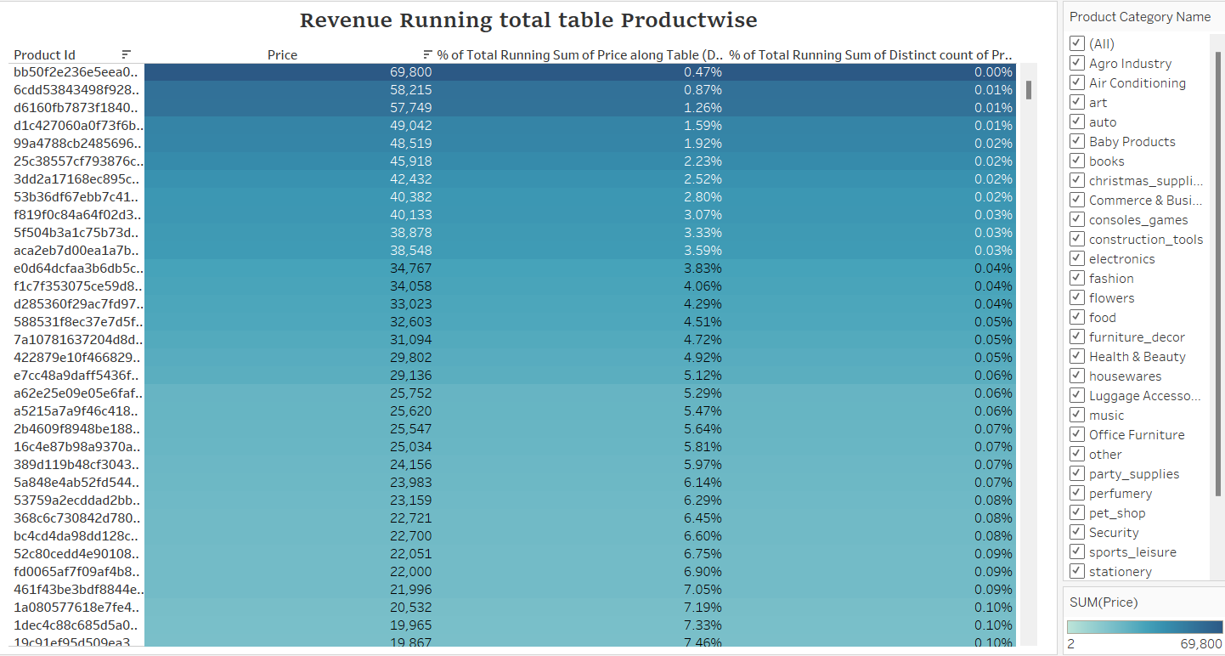
Following visual has a list of products with their corresponding prices in descending order and their percentage share out of the total quantity of orders. Categories like flowers, books, Agro Industry and food have costly items with higher percentage of revenue.

Slide 11
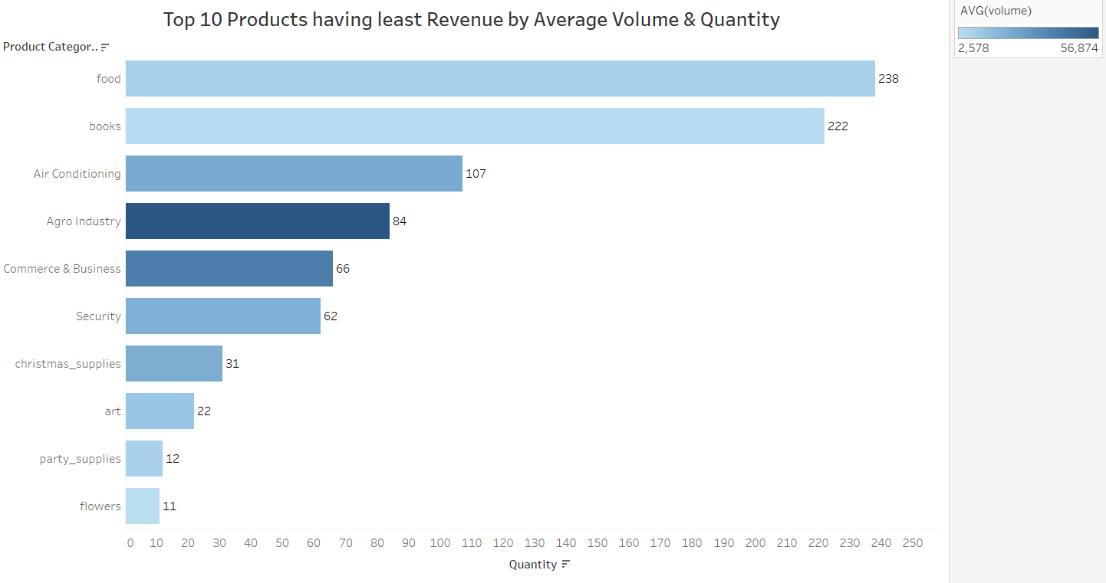
It can be clearly inferred that Agro Industry category has higher Average volume and is very low on quantity as well as revenue.

Slide 12

Market Basket Analysis
Market Basket Analysis is one of the key techniques used by large retailers to uncover associations between items. It works by looking for combinations of items that occur together frequently in transactions.

Slide 13
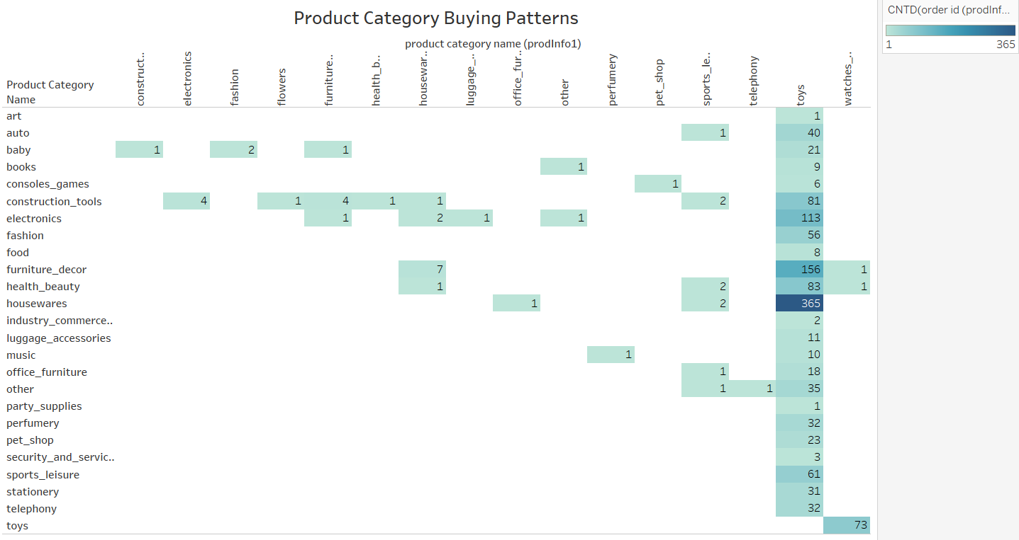
As it is highlighted that for toys category, there are 365 orders where products were bought from housewares category. This shows that people generally buys toys and houseware products together.
Second highest combinations of orders is of toys and furniture décor categories.
The empty boxes depict that there were no orders where both the products were bought together.

Slide 14
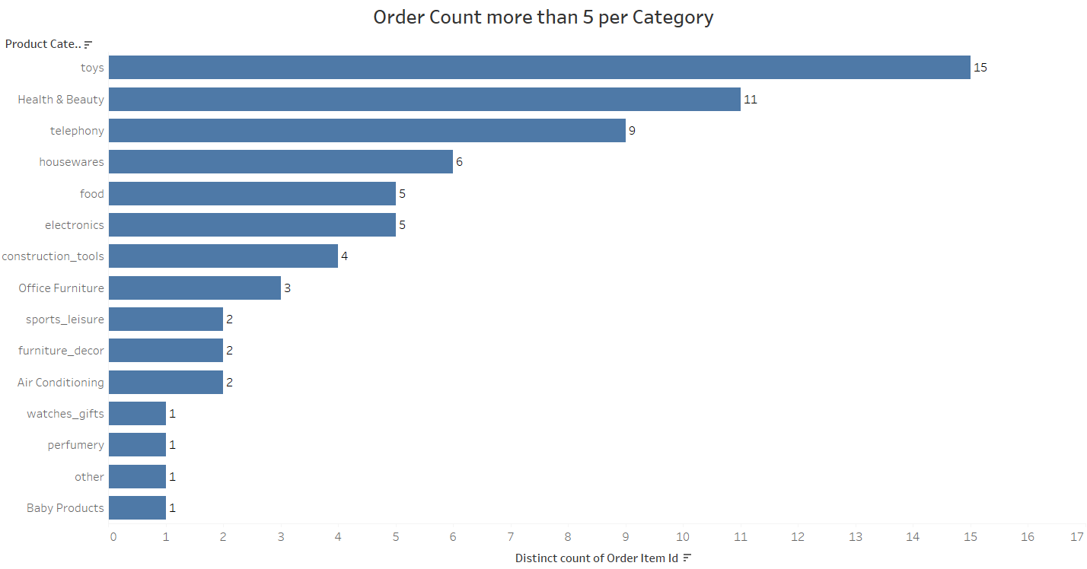
Following are the categories for which customers have purchased more than 5 products at a time.

Slide 15
Conclusion & Suggestions
Since toys are the categories which are bought by so many customers, hence attractive deals can be provided to increase the sales.
Categories like Office Furniture, Agro Industry, Commerce & Business, Luggage Accessories have really high Average volumes and low revenue. So they can be discussed and some products can be removed to save more space.
Watches_gifts category is contributing to 5th highest revenue which has less quantity as compared to sports_leisure which has 6th highest revenue. Hence, its better to focus on the categories which has high revenue.
Category like flower and food can be considered to be kept less in warehouses as the demand seem very less and they don’t have low shelf life.
Salesman should promote different offers for customers to buy categories like toys and houseware together.
Christmas Supplies can be avoided in off seasons.
Company can provide offers with credit card as it is mostly used payment method amongst customers

Slide 16
Thank You

